Slide 1



SRS for Security Management System
Name:-Deep Mehta -21002170110075
Name:-Ronak Dave -22002170220009
Name:-Harsh Vaghela -21002170110204

Slide 2

Problem Statement:-
Current crime reporting systems suffer from inefficiencies and lack user-friendly interfaces, leading to underreporting and hindering law enforcement efforts.
There is a critical need for a comprehensive Crime Reporting System (CRS) that streamlines reporting processes, enhances data accuracy, and facilitates communication between citizens and law enforcement agencies to improve crime prevention and investigation outcomes.

Slide 3
What is Crime Reporting System ?
Easy Digital Reporting: A software crime reporting system provides an intuitive and user-friendly interface, simplifying the process for citizens to report crimes promptly and accurately, reducing underreporting due to complexity or inconvenience.
Enhanced Data Accuracy: By digitizing the reporting process, the system reduces errors and inconsistencies inherent in manual reporting methods, ensuring that law enforcement agencies receive accurate and reliable information for more effective crime analysis and response.
Improved Coordination and Efficiency: The system facilitates smooth communication between citizens and law enforcement, enabling real-time updates on reported incidents, enhancing collaboration, and allowing for more efficient allocation of resources to address emerging crime trends and hotspots.

Slide 4
More About Crime Reporting System:-
We’ve developed an easy user interface which allows the user to report, track and view crimes.
User can report emergencies and law enforcers can track geo-location easily.
Digitalisation of old archives (previous cases) can be done to reduce clerical error

Slide 5
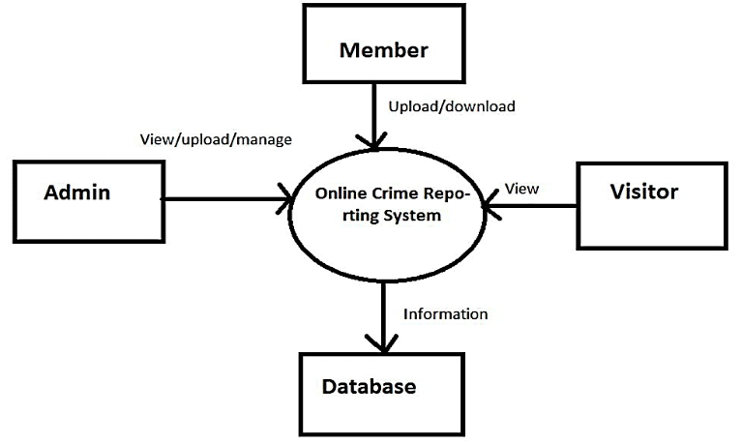
System Architecture
The fundamental flow of Crime Reporting System

Slide 6
Key Features :-
Manage Record System: This system is used to manage or save the record like cases and protect the privacy of informer and prevents the reported information etc.
FIR System: Managing FIR in this system is used to manage the FIR like edit my FIR.
Nearby Searching: Search nearby police station and SOS call/messages.

Slide 7
How our Software helps?
Our software helps in preventing dreadful experiences by creating a user community.
Also by digitalising the system there is less paper work.
SRS system with all these features is speedy, secure and safe
The presence of the software being online the source of availability and help is immediate for user.

Slide 8
User Interface :-
Home Screen
Report a Crime Form
Crime Tracking
Search Feature
Help and Support

Slide 9
Requirements :-
Systems will operate on system like Microsoft, Apple Mac OS, Linux, Android and IOS on latest.
The system in developed in C++/Java. The color scheme is blue family.
Only English language shall be used.
System shall be built for 4GB RAM systems and above

Slide 10
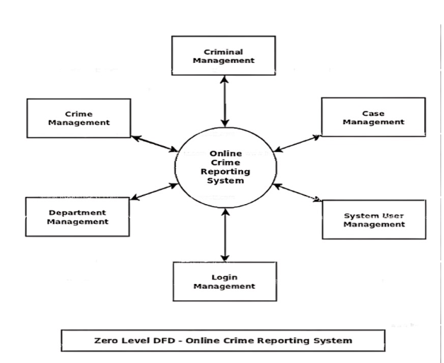
DFD (Zero Level)

Slide 11
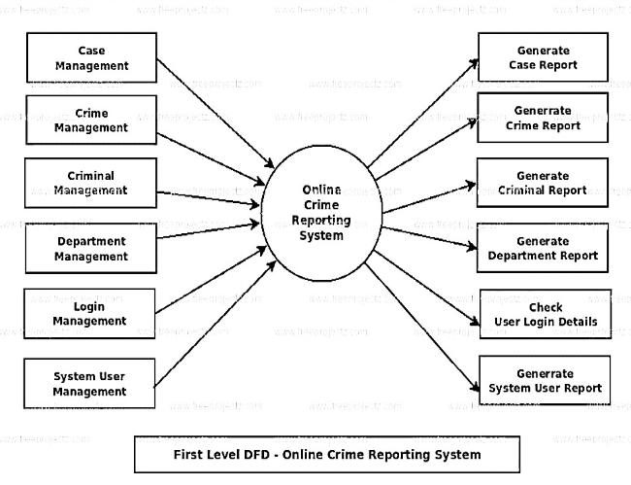
DFD (First Level)

Slide 12
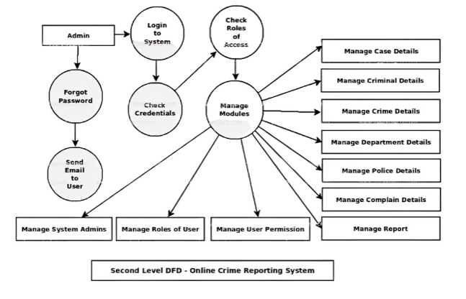
DFD (Second Level)

Slide 13
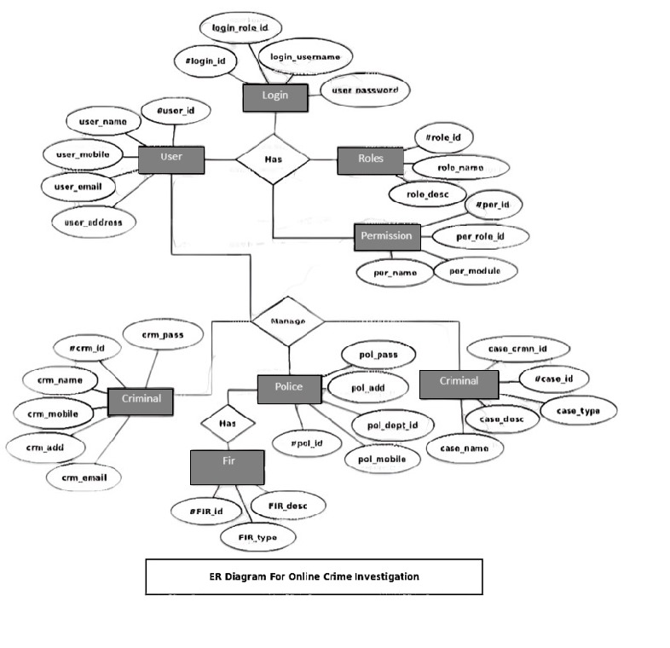
Entity relationship Diagram (ER)

Slide 14
Future Scope:-
We need to make system software platform independent.
Thus also by making it accessible from big cities to small villages and even rural areas.
Expanding the system's statistical database with additional archives and case studies alongside traditional paper-based records, enriching crime analysis and providing comprehensive insights for law enforcement agencies.

Slide 15


